Slide 1

Are You Ready For A Puppy?
Are You Ready For A Puppy?
By Jaden Belyea
This sample slideshow will introduce you to many common PowerPoint techniques.
By recreating this slideshow, you will learn much of what you need to know to make your own presentation.

Slide 2
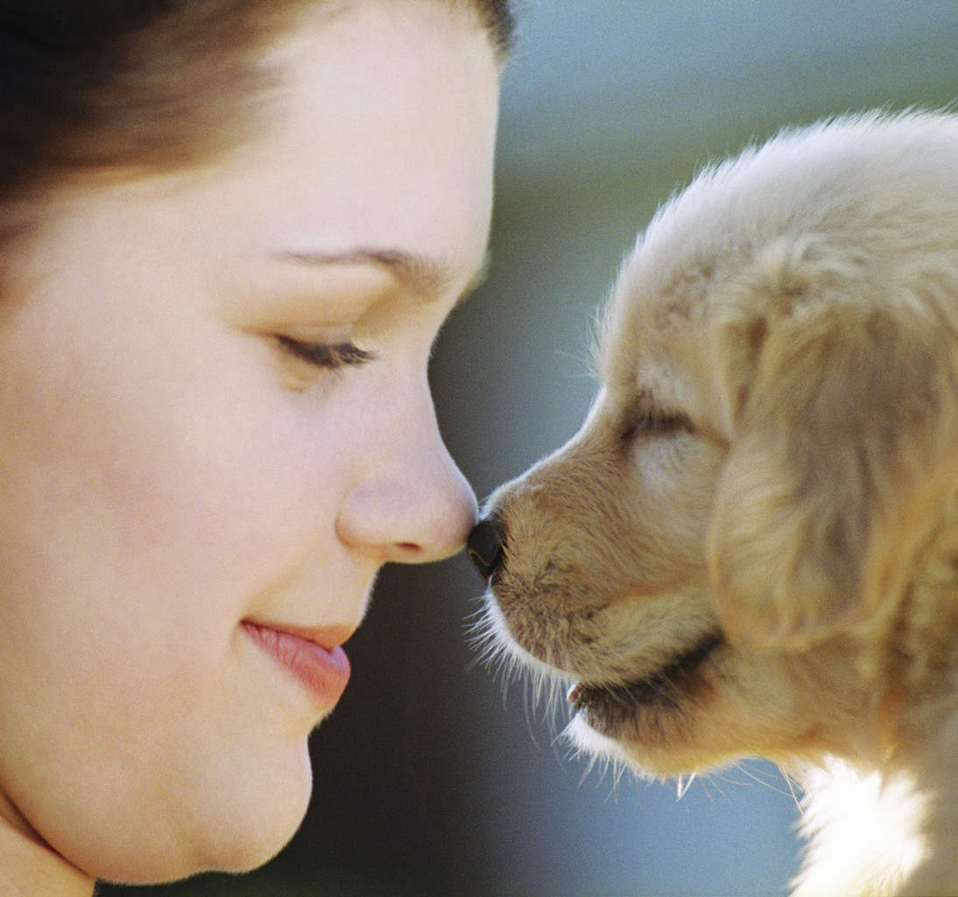
Thinking About Getting a Puppy?
If you’re thinking about getting a puppy, you’d better do your homework first. You’ll need to think about…
What type or breed of dog?
Why you are getting a dog?
Where you will get it (pet store, friend, shelter…)?
How much time and attention you can give to a pet?
How will the puppy affect the routines of you and other family members?
Whose dog will it be? Often when the kids move out, they leave “their” dog for their parents to look after.

Slide 3




What Your Puppy Will Need
Kennel/Crate/Bed
-This gives your Pup a place of their own
Collar & Leash
As they grow, expect to require several collars
Don’t forget ID tags in case they run away or get lost
Brush, Comb & Shampoo
Keeping your puppy clean will make everyone happy
Dog Food
Keep them healthy with a high quality puppy food
Dog Toys & Treats
Toys provide fun and exercise
Treats help reward and train your Puppy
Toys and treats will help save your shoes and furniture
Love, Patience and Attention
Spend time with your Puppy to help it grow up to be a good dog

Slide 4



Puppies Need Play and Exercise
Puppies need to play and get some exercise every day.
When they are very young, they will usually get enough exercise on their own.
But, as they get older, it is often necessary to take them for walks or outside to run around.
You can buy toys or use things like stuffed animals. Watch out for things they could swallow.
Be sure to inspect toys regularly and discard them when they become worn or dangerous.
Don’t forget to give them plenty of water both before and after they exercise.

Slide 5


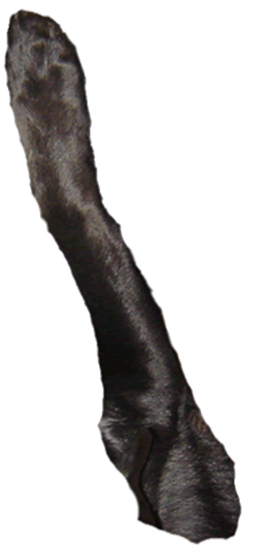
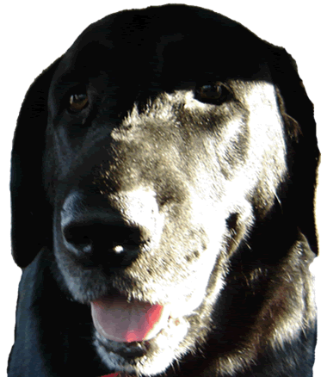

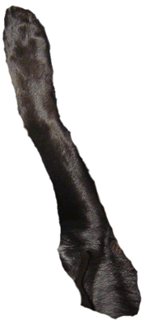
Puppies Grow Up & Up & Older Too
Your house or apartment needs to be big enough to house the dog as an adult as well
Remember that having a dog is a long-term commitment
Keep in mind that some breeds will grow to be quite large
Depending on the breed, you can expect to have your “Puppy” for the next 10-15 years

Slide 6
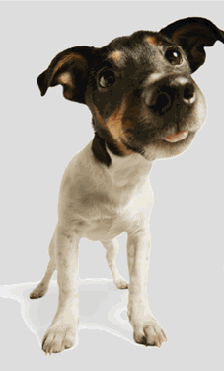
So…
Are You Ready
For A Puppy?
Thanks for Watching
(And Good Luck With Your Pup)

